Slide 1

Plant Healthify
Presenter: Abhipsa, Xiaoling, Cade(Zixu)

Slide 2

Contents
Introduction
Physical Device
Digital Place
Demonstration
Future Improvements

Slide 3
Introduction
Two complementary devices: one physical and one virtual to analyze and observe the critical functions of the plant monitors.
The purpose of the physical device is to display the count of plant monitors in dire need of watering. Along with the number of plants, it is important to show the name of these plants.
The purpose of the digital device is to display the moisture value of a single plant on scanning a unique AR marker. Additionally, in order to map the plant, a 3D model specific to the plant is displayed in Augmented reality.

Slide 4
Physical Device
3D model printing design
Two functions
Servo: Percentage of the plant that need watering (0%-100%)
LCD display logic
Challenge:
Different colour and different background to show the level of moisture

Slide 5
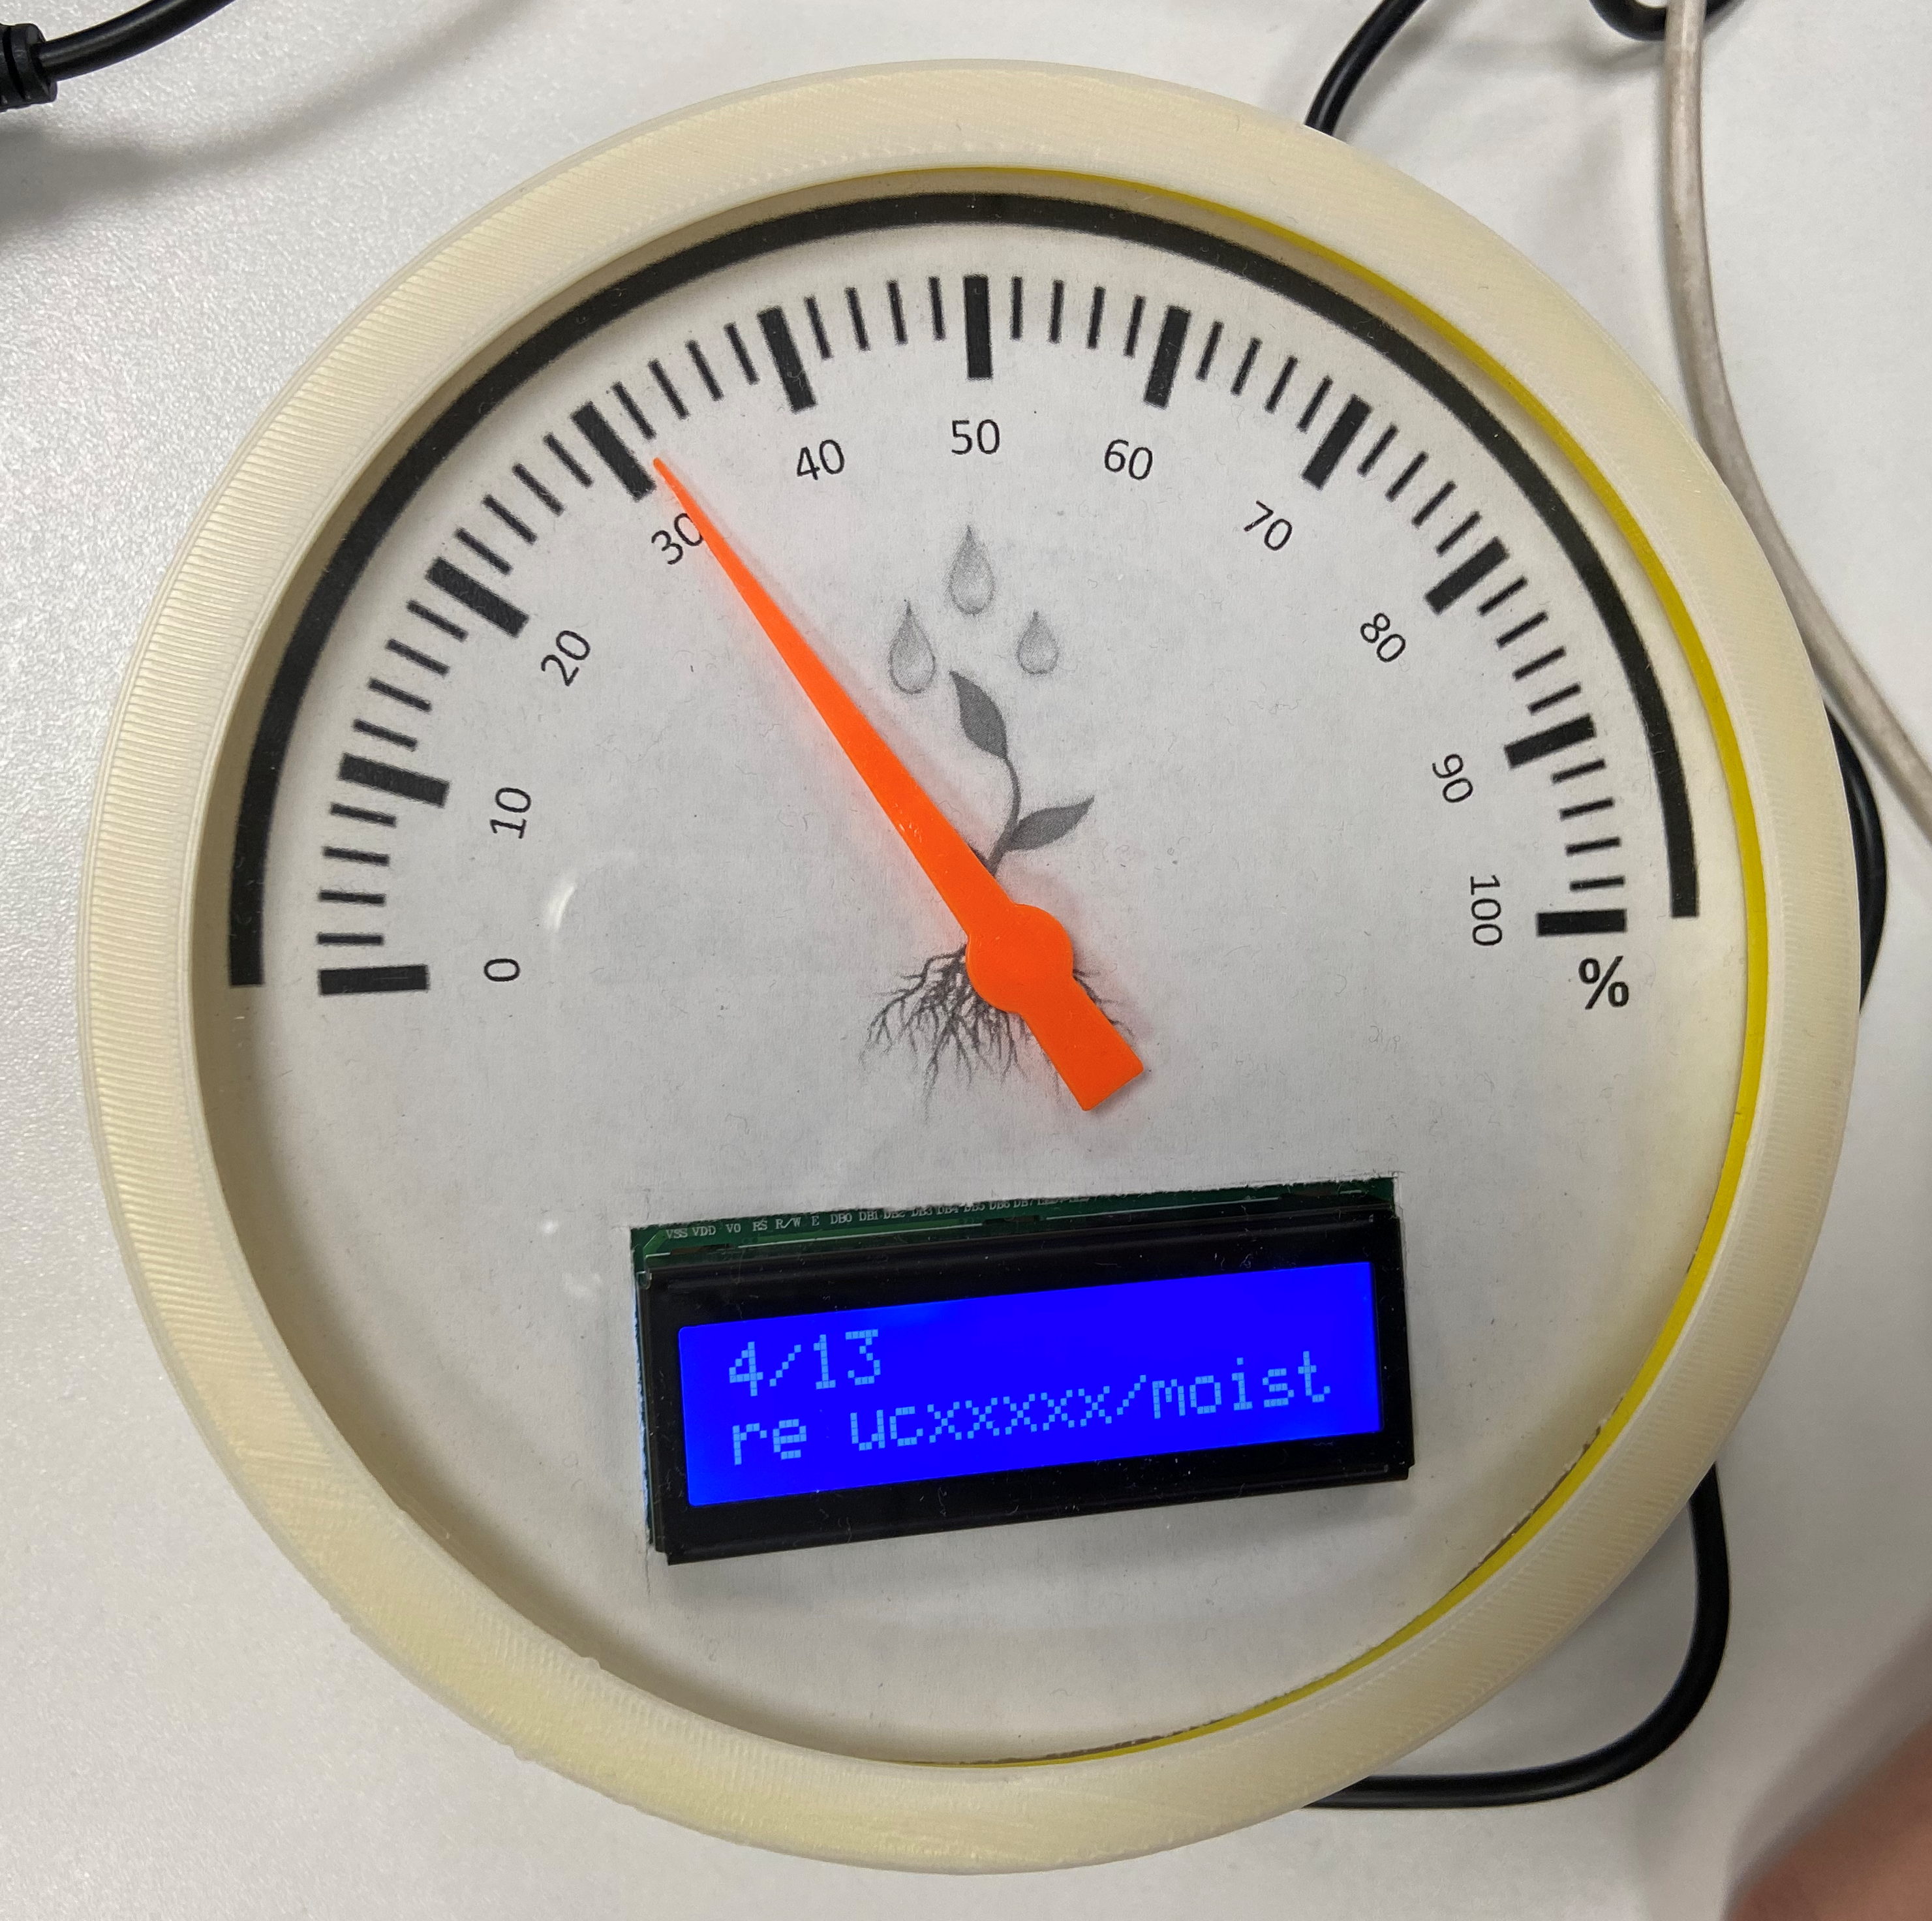
Physical Device-1
3D model printing design
Fix pointer to the servo
Gears no need
Change the length of the pointer
Challenge:
Hanging fixed LCD
Make lcd and dial in the same plane
Remember to Adjust the initial position of the pointer
Wiring management
Limited space

Slide 6
Physical Device-2
Two functions
LCD display logic
Building circuit
Display information in two lines
Print count and length in the first line
Auto scroll on the second line to show the name of thirsty plants detected
Servo: Percentage of the plant that need watering (0%-100%)
Collect topics from mqtt
Count the topics where the plants need watering(count/length)
Map function used (0-100 to 0-180)
Notes:
Components used: Arduino UNO Wifi rev2
Strip board, Servo
Jumper cables
LCD

Slide 7
Physical Device-2
Challenges during creation of physical device:
Not able to fix the first line and just scroll the second line
Content of the second line will cover the first line after a period of time since the length of the string is too long
'Autoscroll' function is not useful to fix the first line and just scroll the second line
how to store data from mqtt for consolidation as MQTT just remembers current subtopic?
MQTT connection is getting stopped frequently.
Notes:
Solutions:
Print the topic letter by letter instead of using 'Autoscroll' function

Slide 8
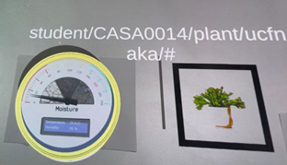
Digital Place
Retexture 3D model in Blender
Build AR Object in Unity
Create, add and recognise markers
Add MQTT topics
Add animation

Slide 9
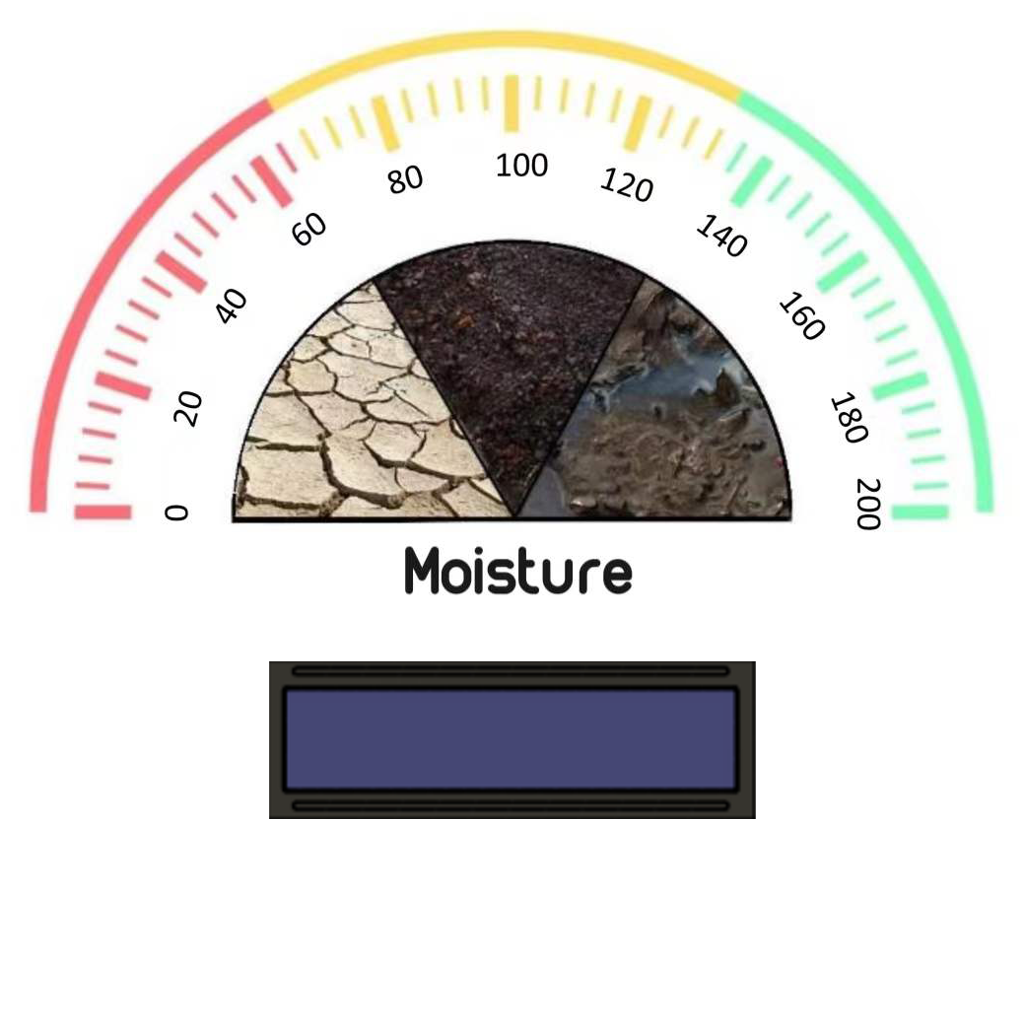
Digital Place-1
Retexture 3D model in Blender
Texture dial face
Texture the glass
Challenge: remember to change to appropriate edit mode
UV editing for dial face
Viewpoint shading for glass ( change render engine to 'cycles' )

Slide 10
Digital Place-2
2. Build AR Object in Unity
Good habit to create new folder to manage your files
3D model need to use external materials (legacy)
Create a prefab for 3D model in the scenes
Edit in prefab model not in the scenes
Add canvas and TextmeshPro UI to show the data

Slide 11
Digital Place-2
Challenge:
Align the canvas to the gauge (solution: using world space mode)
Using TextmeshPro in 3D object cannot change the text to real data (remember to use that in UI)

Slide 12
Digital Place-3
Create and add markers
Create markers and add them to Reference Image library
Recognise the markers from AIImgRecognition.cs
Challenge:
. how to get data from 3 sub topics for a single AR object?

Slide 13
Digital Place-4
4. Add MQTT topics
MQTT controller
onMessageArrivedHandler function （string msg -> MQTTobj）
This pointer to change corresponding texts of topic name and data
Challenge:
. how to use multiple mqtt topics for multiple markers.

Slide 14
Digital Place-5
5. Add animation
Lean selectable script
Lean pitch scale

Slide 15
Future improvements
Adding lights to the physical dial for better visibility
Add all markers at a sufficient distance on a plaque.
Moving forward with the theme of extracting most critical data, the data device would check the parameters of plant monitor and show the parameters which are below threshold level for the specific plant requirements.
Think about reducing the wait time of MQTT data for the first time after connection for the physical and digital gauge.

Slide 16
Thanks for listening

